Slide 1
Interactive Visualization and Analysis of Spectral Energy Distributions and Galaxy Environments in NED
By Edward Hernandez

Slide 2
Objective
develop an interactive data visualization for the purpose of studying galaxy SEDs and Galaxy Environments
Replace the static graphics currently on NASA/IPAC Extragalactic Database (NED)

Slide 3
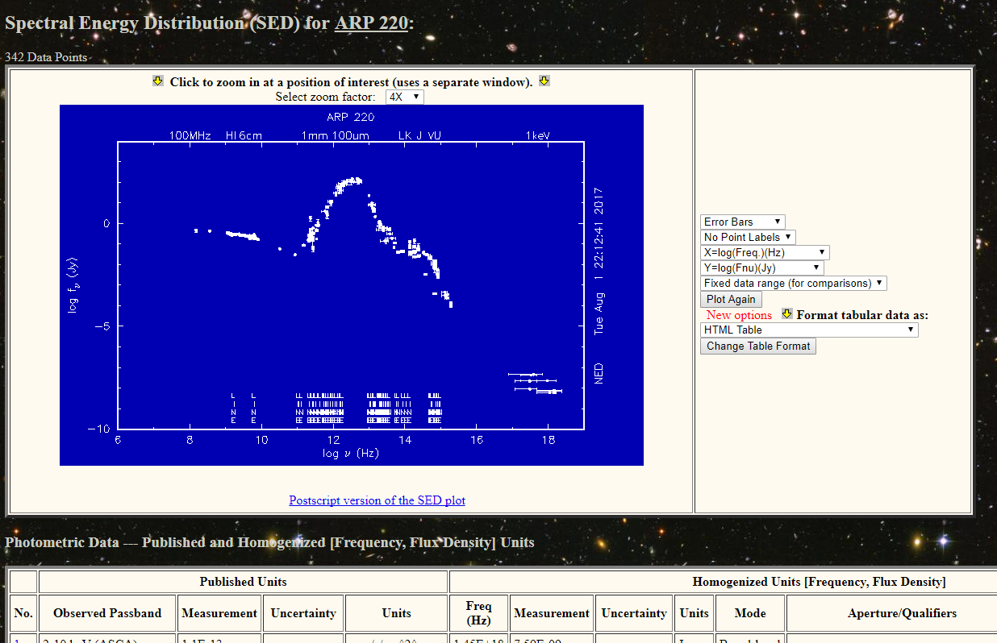
Classic View
Current Issues
- Information not in the same viewpoint
- Can not identify point easily
- Visualizing spectral lines is not ideal

Slide 4
SED Features
Filter photometric data points
Fitting
Zoom and Pan
Change axis units
vary symbols
Compare the SEDs of two or more galaxies
Toggle Spectral Line Measurements
Identify data point information

Slide 5
Live Demo

Slide 6
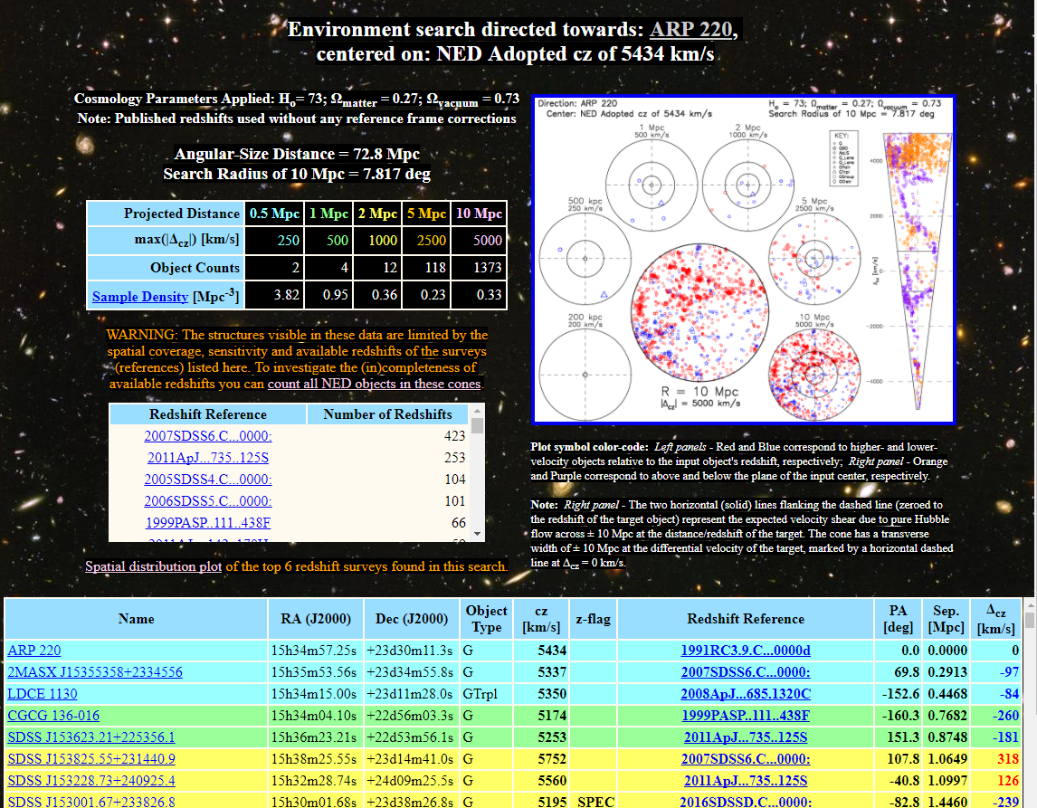
Classic View
Current Issues
- Static graphics
- Can not identify point easily
- 2D interpretation of 3D environment

Slide 7
Galaxy environment Features
Filter data points
Fitting
Zoom and Pan
Change perspecitve
vary symbols
Single view to show different volumes of space
Identify data point information

Slide 8
Live Demo

